Slide 1
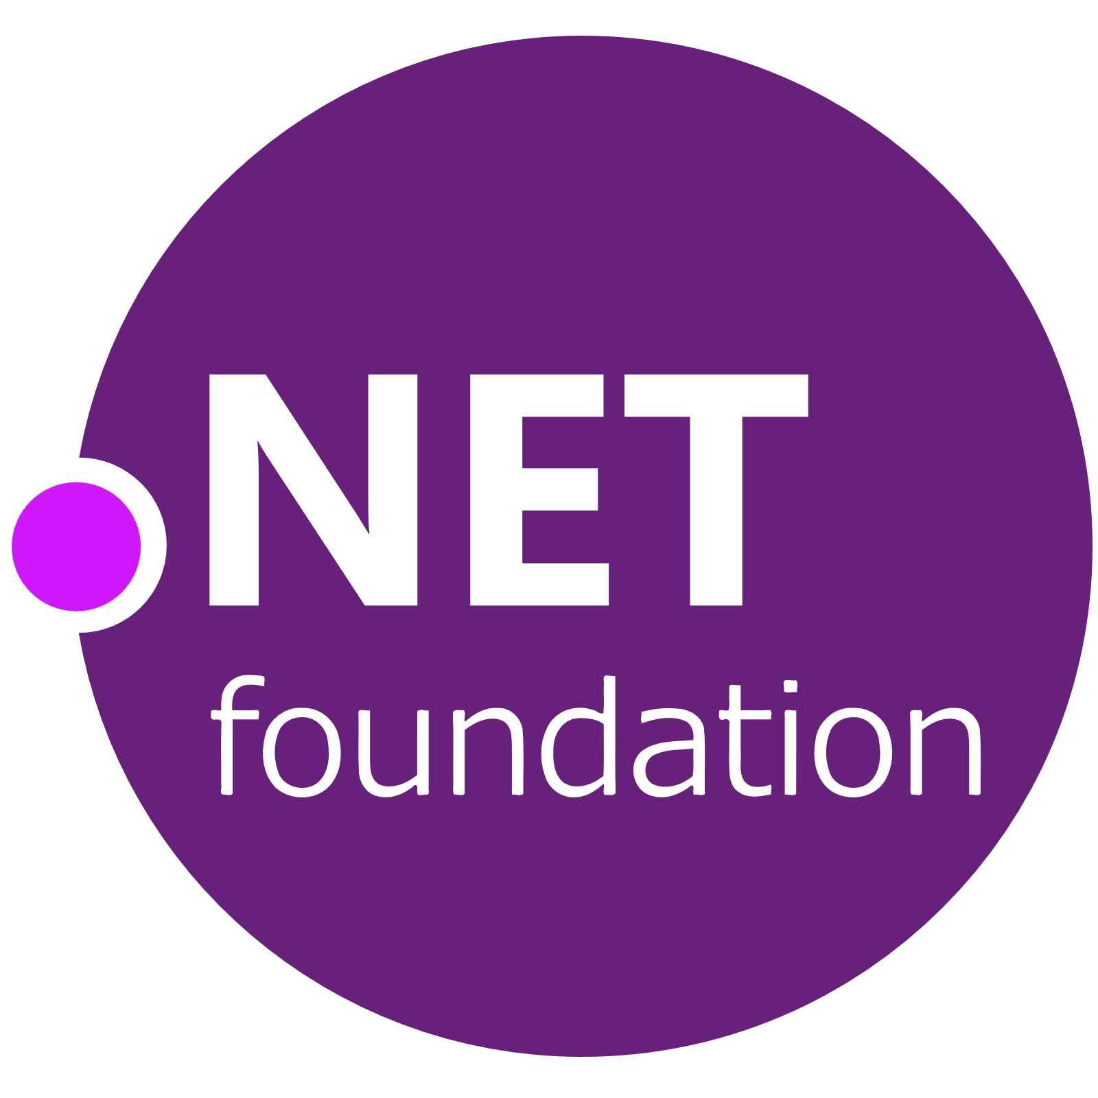
Jon Galloway | @jongalloway | jon@dotnetfoundation.org

Slide 2
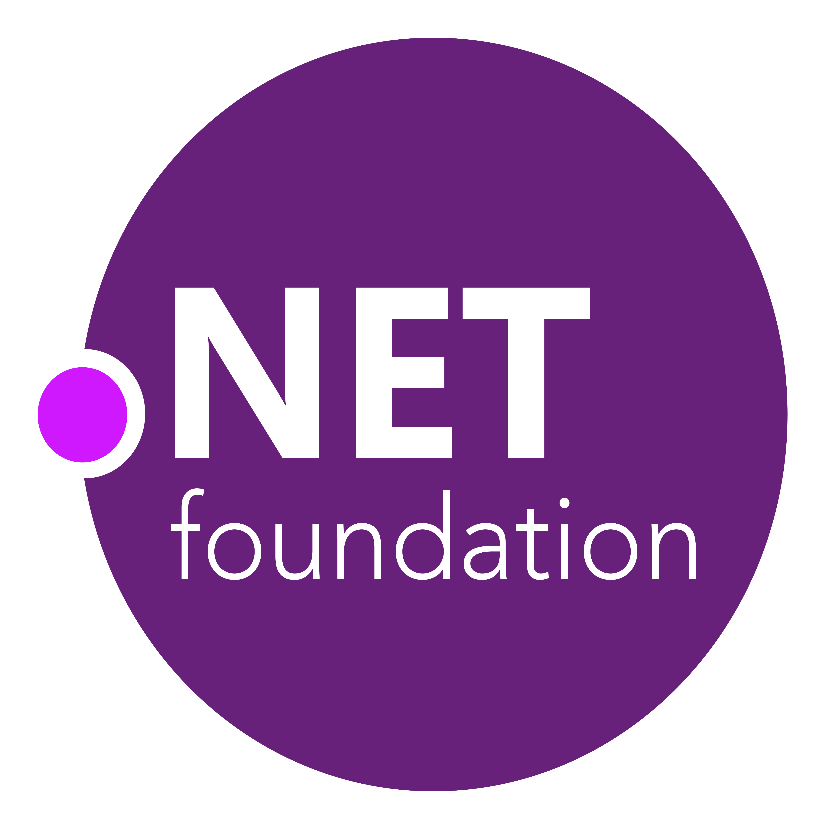
.NET Foundation: Part of .NET OSS Evolution
2001
ECMA 335
2008
ASP.NET MVC (web platform) open source
April 2014
.NET Compiler Platform (“Roslyn”) open source
.NET Foundation founded
2002
NET 1.0 for Windows released. Mono project begins

Slide 3
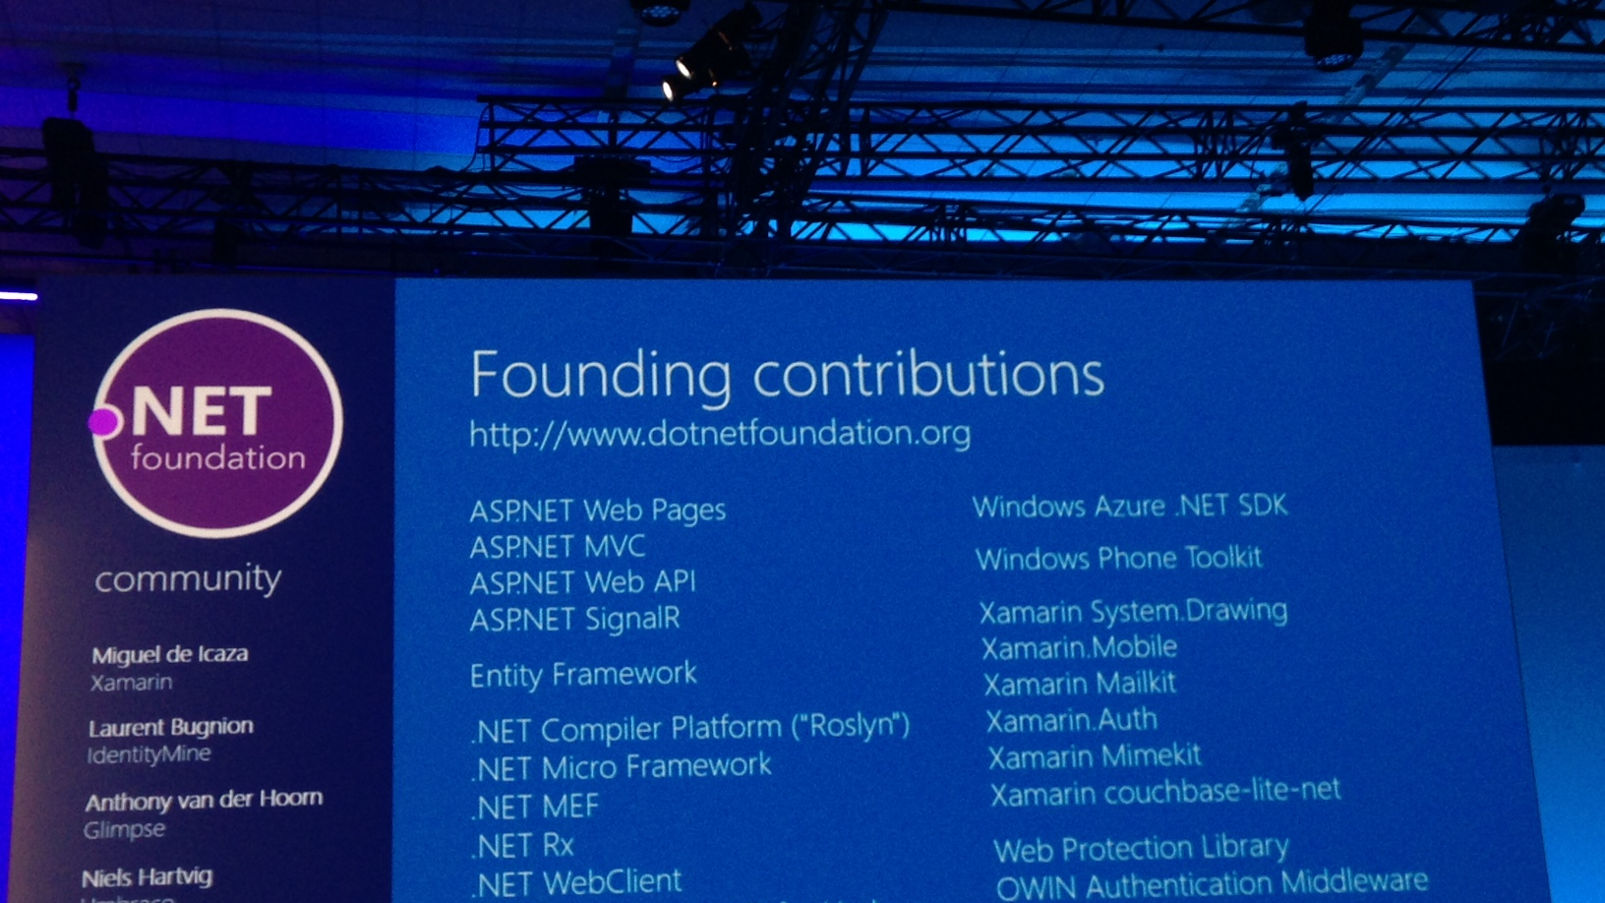
2014: .NET Foundation Announced

Slide 4

Circa 2014: .NET was a part of Microsoft
Microsoft .NET

Slide 5








After: Microsoft is a part of the .NET Foundation

Slide 6

.NET Foundation: Part of .NET OSS Evolution
.NET
Aug. 2017
.NET Core 2.0 released
2001
ECMA 335
2008
ASP.NET MVC (web platform) open source
April 2014
.NET Compiler Platform (“Roslyn”) open source
.NET Foundation founded
Fall 2019
.NET Core 3.0
2016
Mono project joins .NET Foundation
2002
NET 1.0 for Windows released. Mono project begins
Dec. 2018
.NET Core 2.2 released
.NET Core 3.0 preview WinForms and WPF go open source
Nov. 2014
.NET Core (cross-platform) project begins

Slide 7

87% contributors outside Microsoft
.NET open source community
61,000+ accepted PRs from community

Slide 8
What We’ve Been Doing
Member Projects
Project Services
Meetups
Marketing and Communications
Support .NET OSS Community
Events

Slide 9

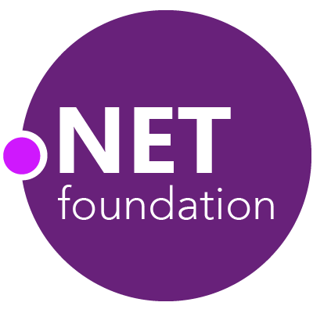
Steeltoe
.NET Core
Microsoft Web Protection Library
MSBuild
DotNetNuke
ASP.NET AJAX Control Toolkit
ASP.NET Core
SourceLink
Microsoft Azure WebJobs SDK
Salesforce Toolkits for .NET
nUnit
MVVM Light Toolkit
IronPython
Mailkit
WorldWide Telescope
Nancy
Open XML SDK
.NET SDK for Hadoop
MvvmCross
MEF
JSON.NET
Mimekit
xUnit
ASP.NET Web Pages
NuGet
IdentityManager
Couchbase Lite for .NET
ML.NET
iOS
macOS
MiniProfiler
Entity Framework
.NET ECOSYSTEM
WCF
ILMerge
Xamarin.Mobile
ASP.NET SignalR
Infer.NET
.NET Micro Framework
StackExchange.Redis
Mono
protobuf-net
Open Live Writer
Xamarin.Auth
Xamarin SDK
Orchard CMS
OWIN Authentication Middleware
ProtoBuild
IdentityServer
Microsoft Azure SDK for .NET
.NET Compiler Platform ("Roslyn")
Prism
ASP.NET Web API
Cake
Orleans
Kudu
Cecil
LLILC
Umbraco
System.Drawing
ASP.NET MVC
Notes:
The .NET Foundation is our center of gravity for open development and collaboration around the .NET ecosystem. The .NET Foundation has over 50 projects and hundreds of repos under its stewardship. Open Source Software foundations provide protection, support, services and best practices for helping each project be successful and to grow the ecosystem of people and software.

Slide 10
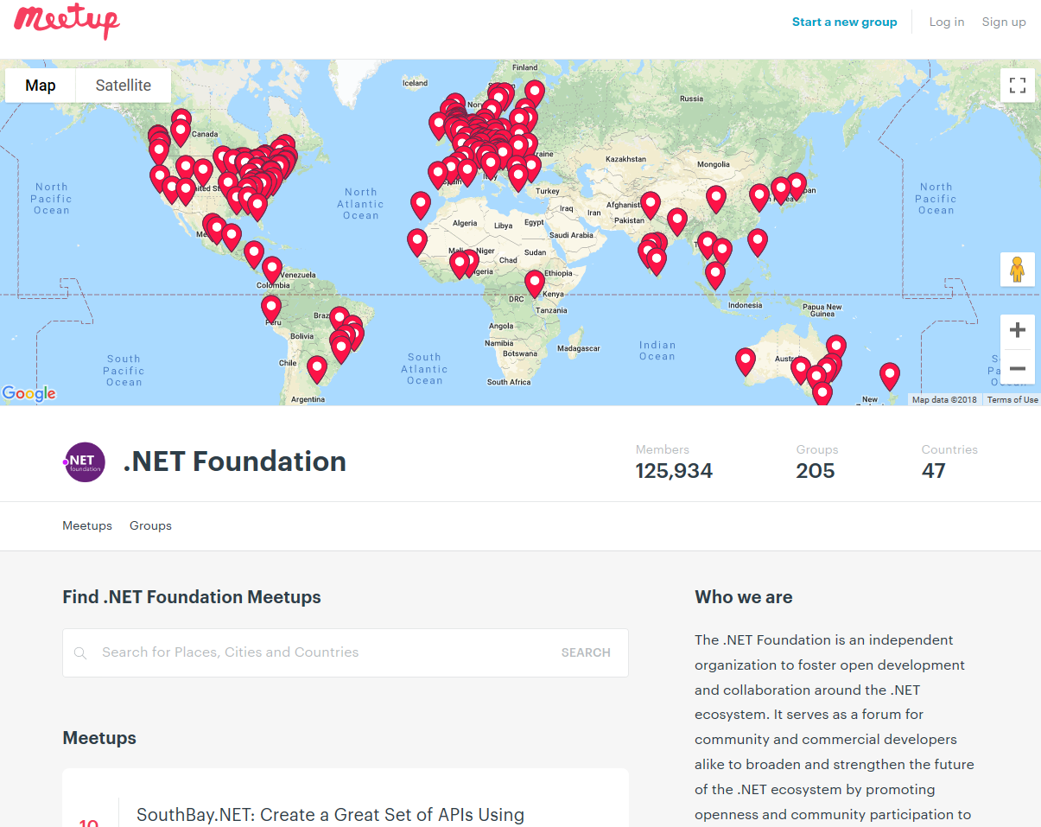
Groups
299
Members
224,000
Countries
60
Join us: meetup.com/pro/dotnet

Slide 11
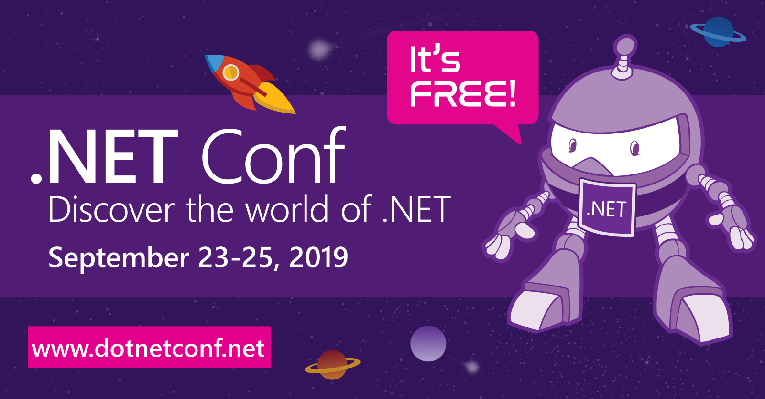
Announcing .NET Conf 2019
Save the date!
Beth TODO

Slide 12
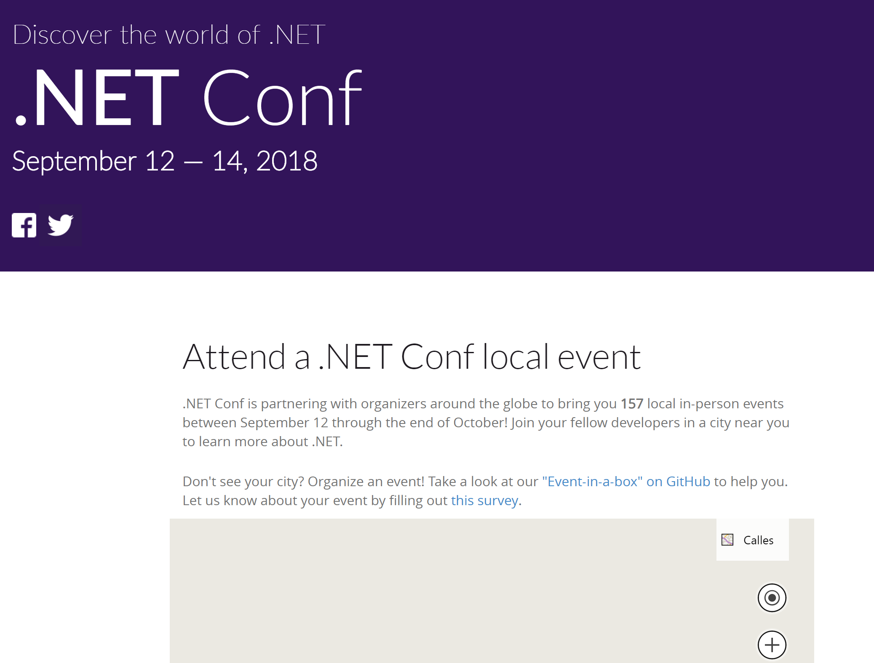
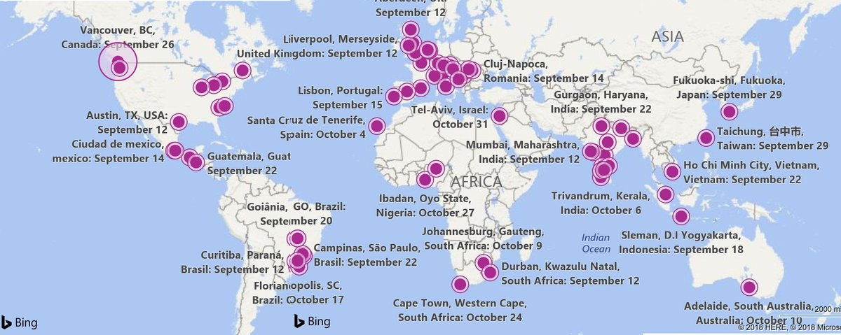

Slide 13
What’s New
Corporate Sponsorship
Open Membership
Open Elections
Action Groups

Slide 14

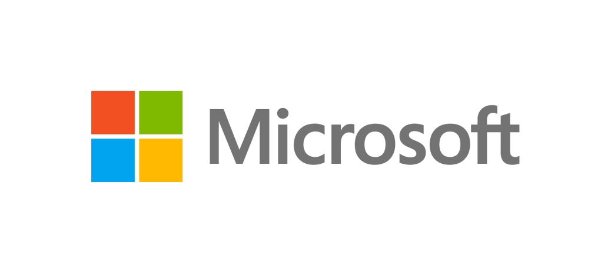
TSG / Corporate Sponsors

Slide 15
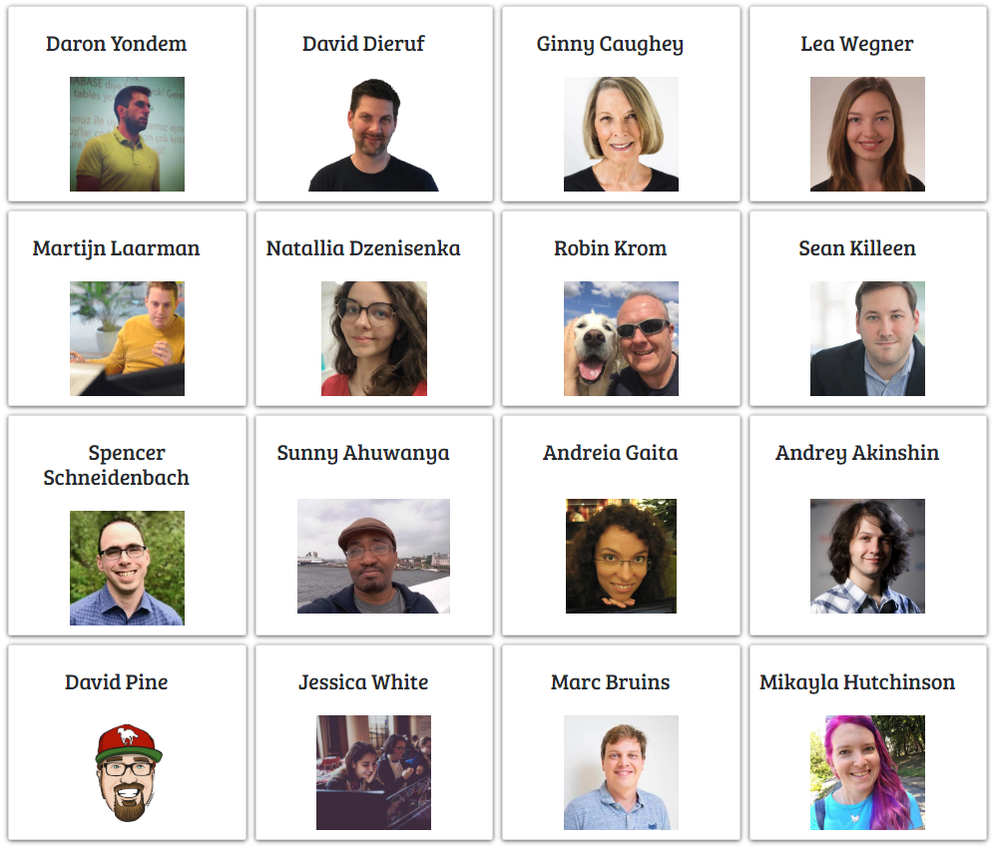
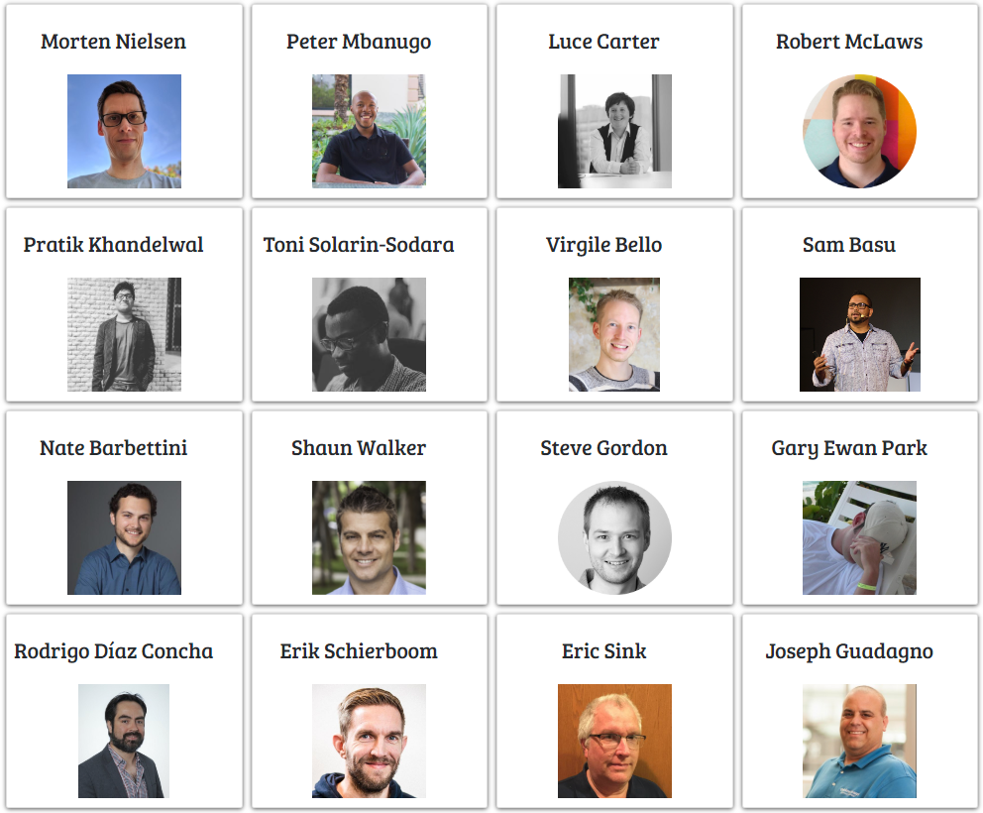
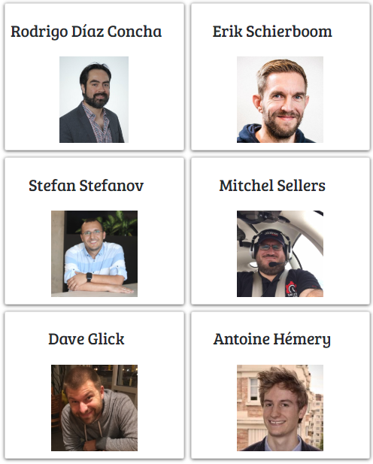


Membership & Elections
500 Members
45 Election Candidates

Slide 16

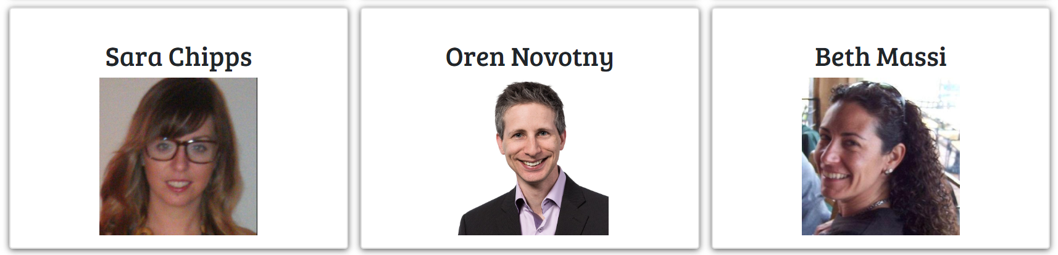
Membership & Elections

Slide 17
.NET Foundation Action Groups
Outreach
Project Support
Membership
Marketing and Communication
Corporate Partnership
Technical Oversight
Speaker Bureau and Meetups

Slide 18
Get Involved
Contribute to .NET OSS
Get Involved in a Meetup
Submit your project for membership
Corporate Sponsorship
Join the .NET Foundation
Join an Action Group

Slide 19

https://dotnetfoundation.org
@jongalloway | @dotnetfdn
jon@dotnetfoundation.org

